Slide 1
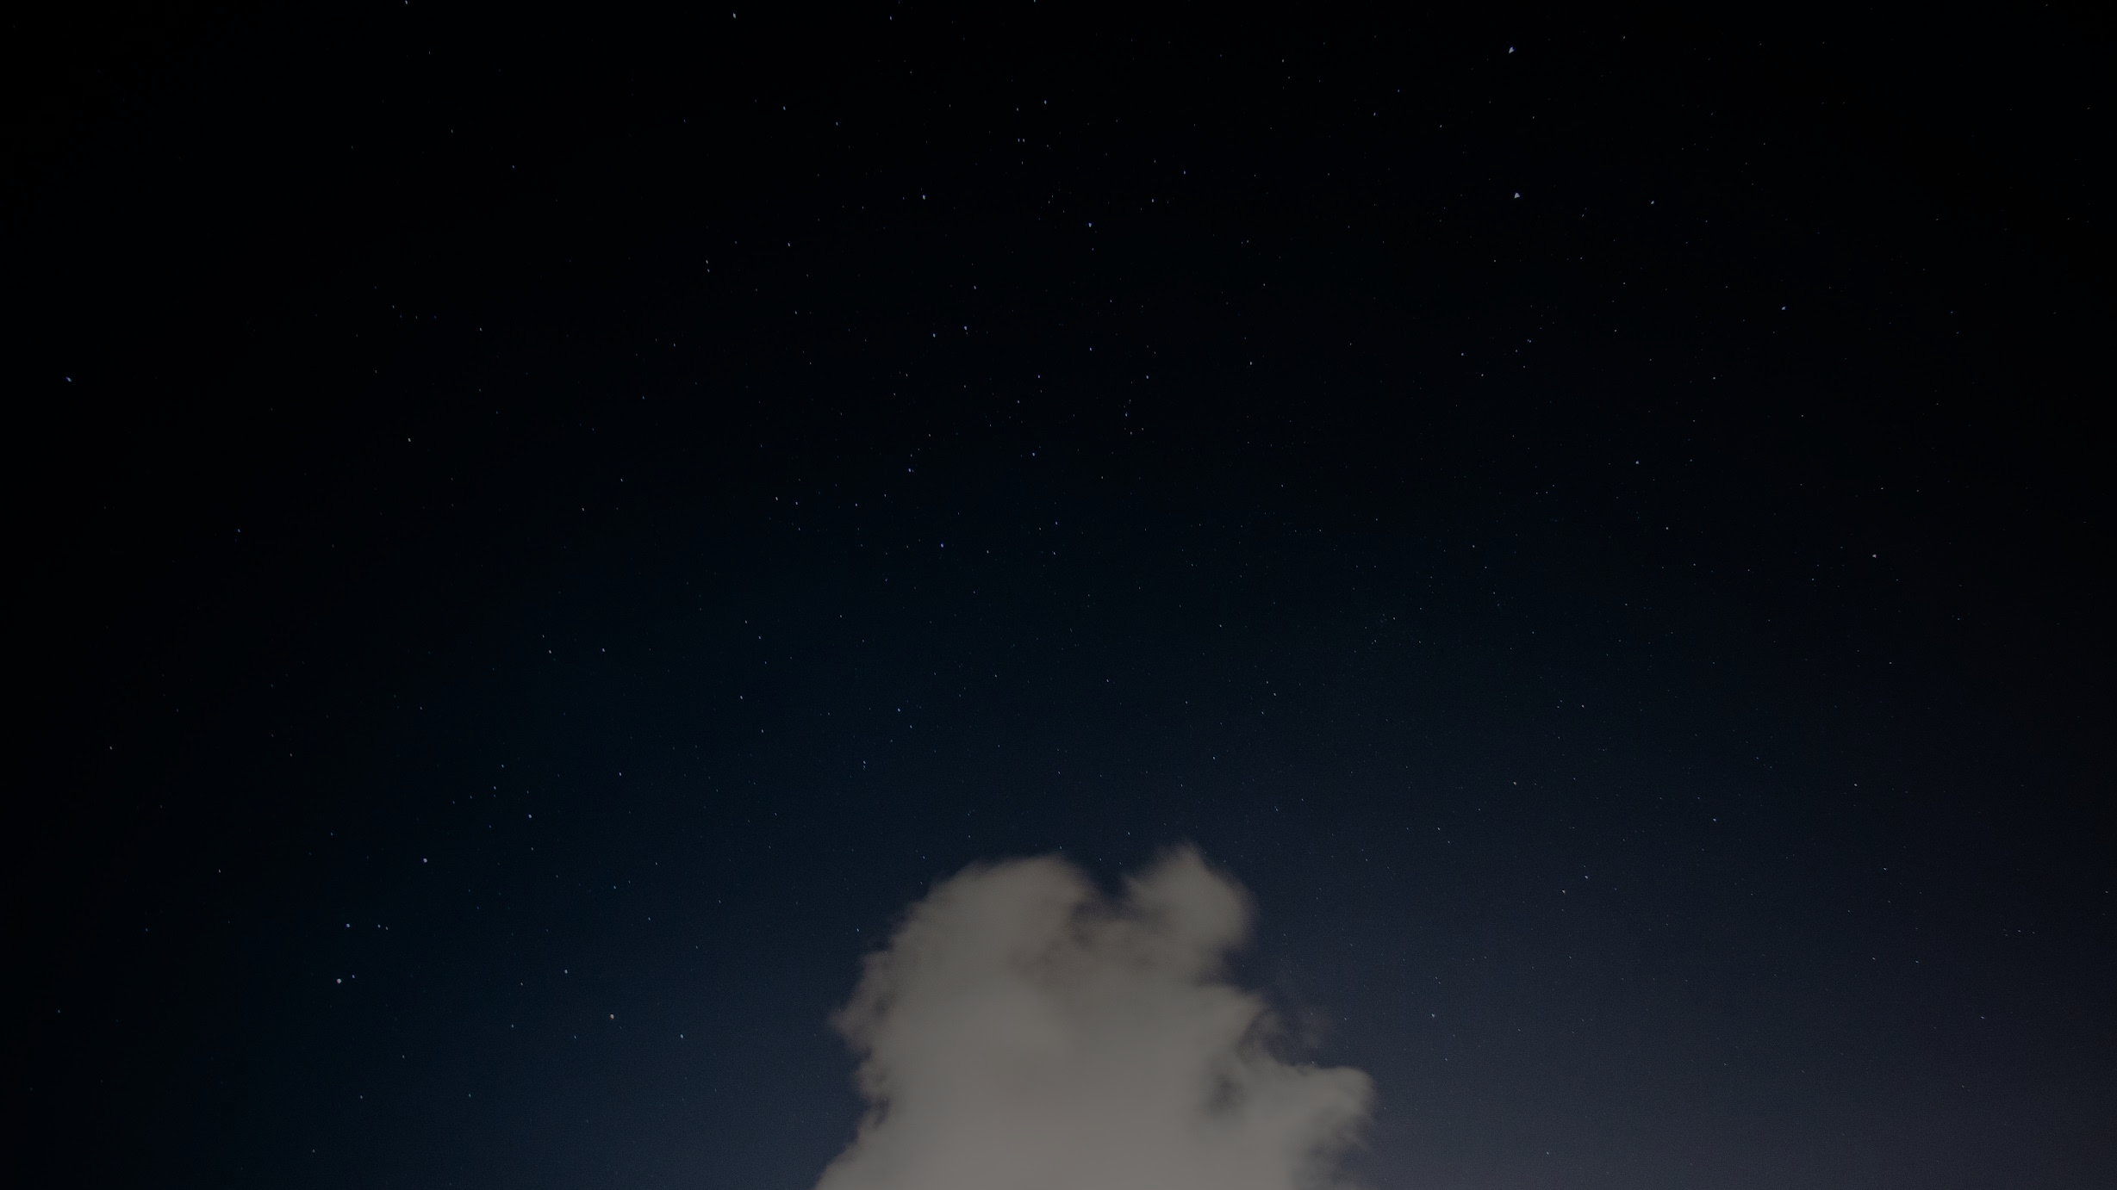
Simulation of Water Over 2-Dimensional Geometric Shapes
By: Alvaro Casales, Emalina Huerta, Kristine Martinez, Jeffrey Morales
https://www.overleaf.com/read/ndnprgxjdvpk

Slide 2
Why we chose this project/reference
Contained Navier Stokes and Immersed Boundary
Stationary object to observe the flow around it
We wanted to do something that contained movement and fluid
Illustration of the force distribution process
It seemed to be a topic we all agreed on and we’re happy to do
Notes:
Alvaro speaks here

Slide 3
The problem or challenge
Getting started
Understanding the concept
Testing various parameters such as Reynolds Number (viscosity), Spring Force Constant, and Computational Domain

Slide 4
Research
Immersed Boundary: Computational fluid dynamics
Navier Stokes: Set of PDE, describing fluid with a thick or sticky consistency
-Force, viscosity, area of object, and rate of deformation

Slide 5
What is Reynolds Number?...
Viscosity = 1/Re
What happens in the simulation as time passes?
Notes:
NOTE: INCLUDE WHAT REYNOLDS NUMBER IS IN OUR PRESENTATION.
- Viscosity in this project is inversely proportional to Reynold's number.
- So in our application, the viscosity is getting smaller as we increase the value of Reynold's number through each simulation.
- Note: Fluid viscosity relative to reynolds number in the next following slides will be shown through the interaction of the flow given a different density in the fluid.

Slide 6
Numerical steps
Calculate the force field over Lagrangian points with force f(x_k)
Distribute the force to the Eulerian grid or fluid domain
Solve for the pressure correction and compute pressure field
Update fluid velocity along the immersed boundary and verify divergence
Our method highlights

Slide 7
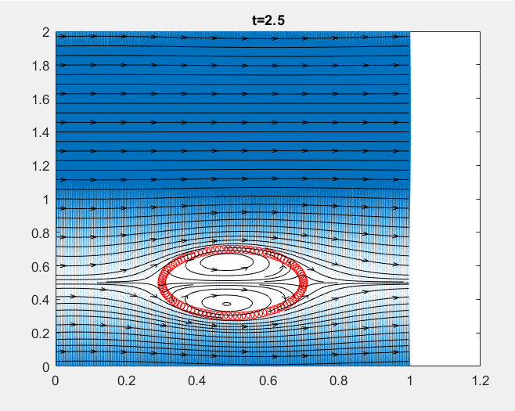
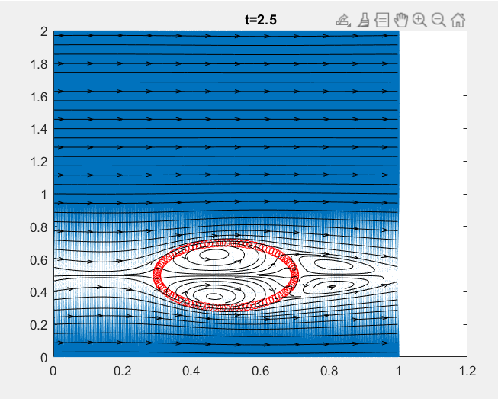
Recirculation Bubble Behind the Cylinder
Fig. (a) Bubble behind cylinder at Re=10
Fig. (b) Bubble behind cylinder at Re=50
Notes:
Slide 6-7:
- For Reynolds number at 10, 50, 100, and 200, the bubble formed behind the cylinder maintains a steady symmetric state.
- In the reference, it was concluded based on its results that the circular bubbles instabilities rise for Re >= 47. In our simulations come to the same conclusions as well.
- Like in reference 13, our results here show different simulations at various Reynolds number at the 250 X 500 grid points.
- As the bubble increases in size as well as the recirculation, the viscosity of the fluid is decreasing. Meaning that the bubble is getting larger as Reynolds number is increasing.
- The results from the reference regarding the recirculation bubbles behind the cylinder concluded that ‘the bubble increases with the Reynolds number’ which is what we concluded as well. This means that our results reflect similarly with what is based on in the article.

Slide 8
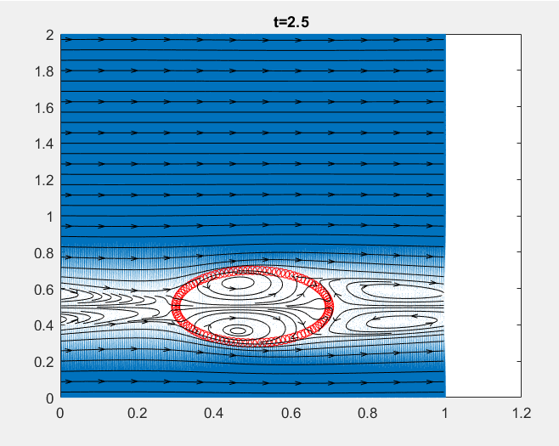
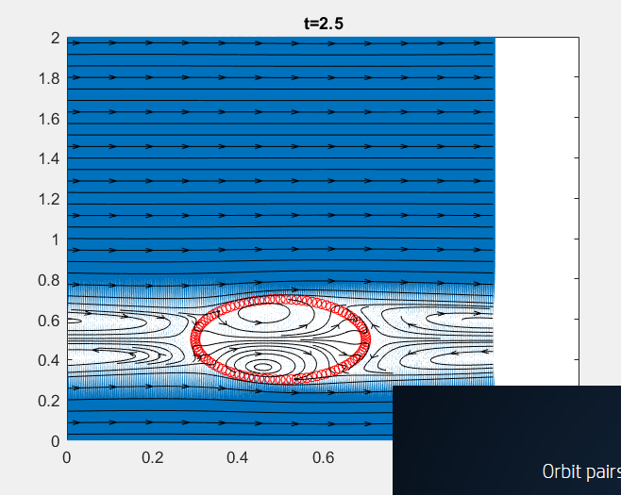
Recirculation Bubble Behind the Cylinder cont.
Fig. (c) Bubble behind cylinder at Re=100
Fig. (d) Bubble behind cylinder at Re=200
Notes:
Slide 6-7:
- Note: fluid viscosity means the interaction of the flow of different densities in the fluid.
- Like in reference 13, our results here show different simulations at various Reynolds number at the 250 X 500 grid points
- As the bubble increases in size as well as the recirculation, the viscosity of the fluid is decreasing. Meaning that the bubble is getting larger as Reynolds number is increasing.

Slide 9
Short videos with Grid Parameters
All at Reynold’s Number at 80
Spring Force Constant at 100000
Different Computational Domains
Spring Force Constant at 100, Reynolds Number at 80, and the force was increased.

Slide 10
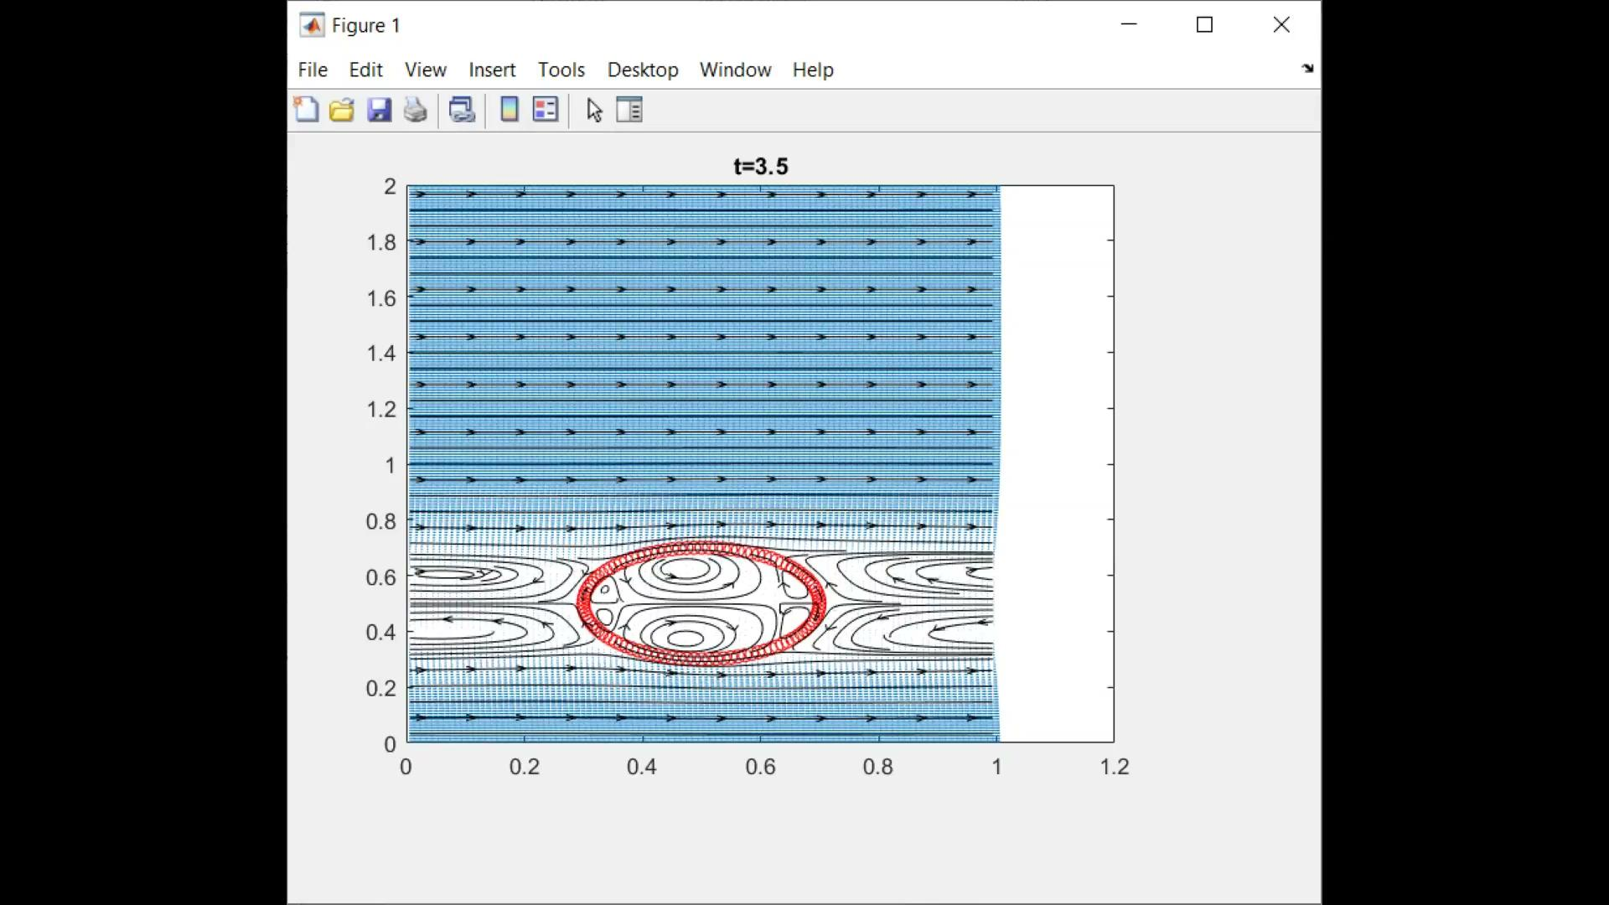
100 x 200 Grid Points
Notes:
Our following short videos show our results at different grid point parameters (different computational domains). By doing various trials with different parameters, we concluded that having a bigger computational domain matters. As each of our grid points parameter increases, we see that the simulation runs a bit longer. The larger we expand our grid points, the more refined our results become in the video shown above (meaning the better video or picture quality one produces). time (t) goes from 2.5 to 5.5 seconds here.

Slide 11
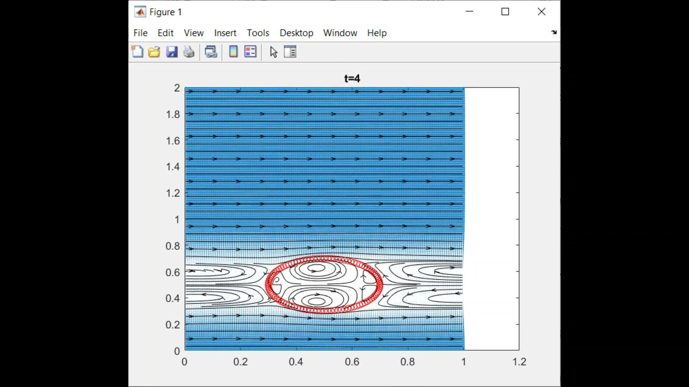
150 x 300 Grid Points
Notes:
t-6

Slide 12
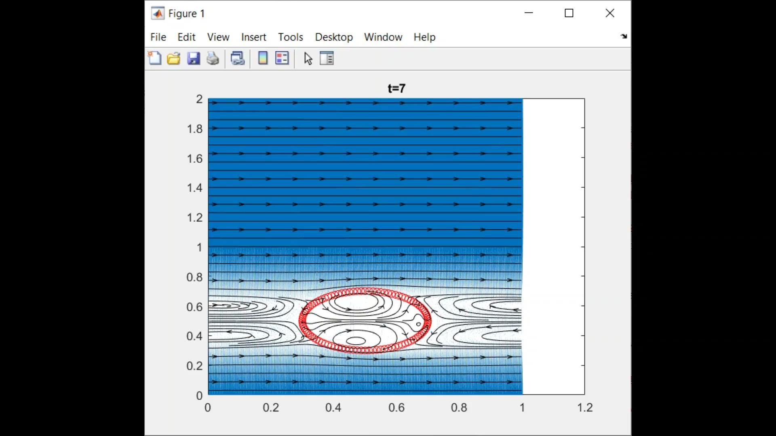
250 x 500 Grid Points
Notes:
t-7.45

Slide 13
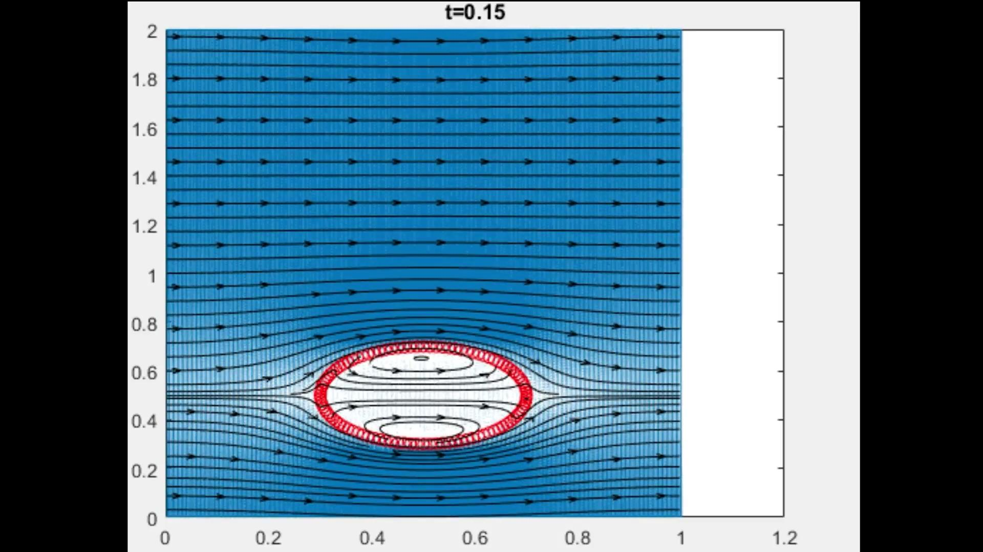
Notes:
At Re = 80. 250x500 grid
Force of zero
We are going

Slide 14
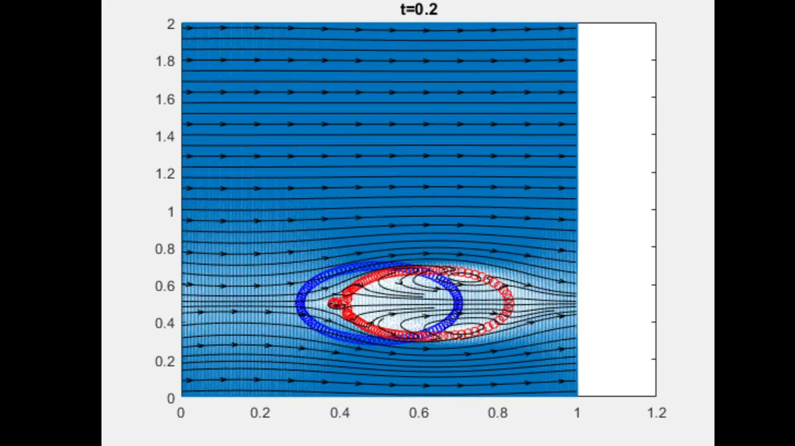
A few things to take away
Notes:
Constant spring force of 100
The force function is now greater than 0 but we have set it weak enough to see small changes over time. We had to speed up our 9 minute video to fit this presentation.
This is where we begin to see deformation
We noticed that the rate of deformation was affected by the force function

Slide 15
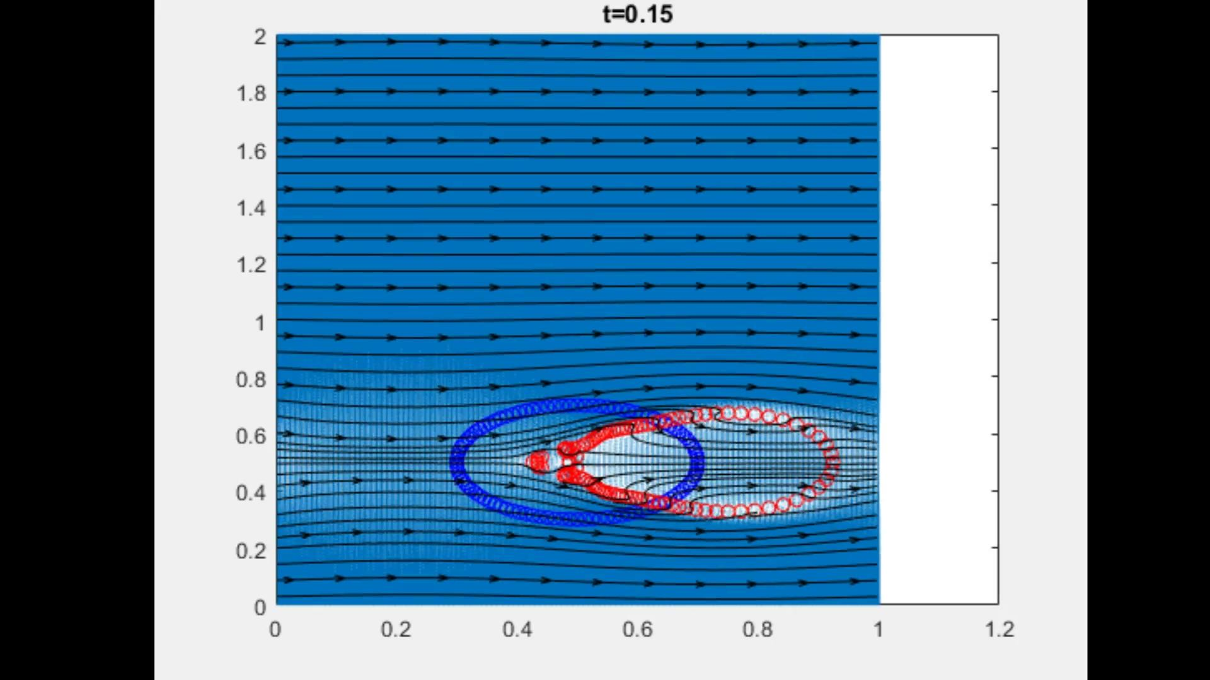
A few things to take away
Notes:
At 2.5 stronger force from the previous slide
We can see that the deformation rate is a lot faster because we applied a greater force than the previous Fu

Slide 16
Conclusion
Our presented work shows the reaction to the bubbles formed (vortex) by flowing fluid and different forces involved. Our report is based on different Reynolds number as well as comparing different parameters .
Our project did not implement the Physical Virtual Model (PVM) used in reference 13 however we were able to get similar results. We learned that to increase the quality of our simulation, we would need more points on the grid. This would increase the time required.
Notes:
Our results were compared with that of the reference ….

Slide 17

Last Minute Findings
When recreating the simulation, we went ahead and did a line segment instead of a circle. It turns out that when viscosity is increased/decreased, it changes the flow of the fluid. Creating different forms of vortexes, wakes and different geometric pathways.

